Slide 1
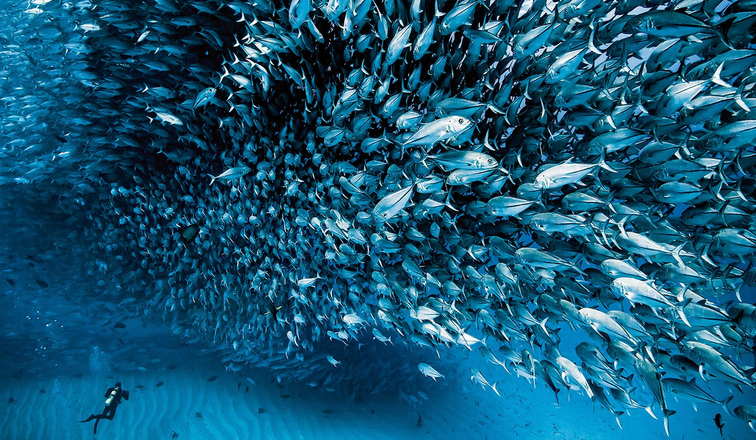
THE GREAT BLUE
OCEAN EXPLORATION AND MARINE CONSERVATION
Scy Elijah F. Santiago

Slide 2
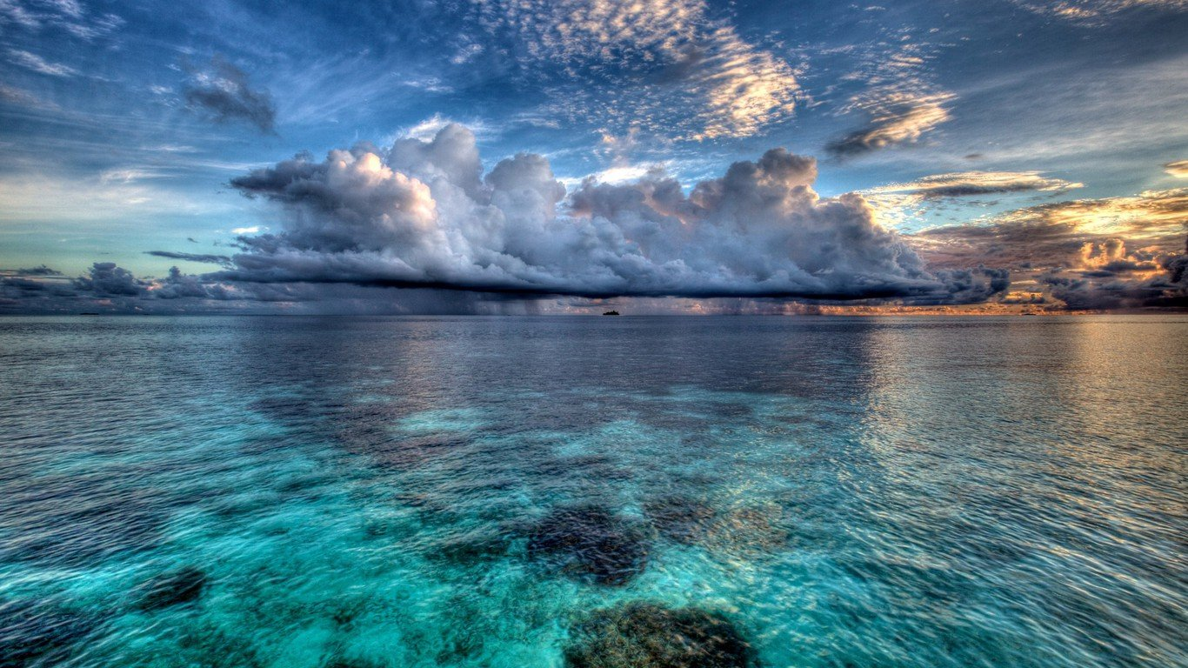


OCEAN
EXPLORATION
MARINE
CONSERVATION

Slide 3
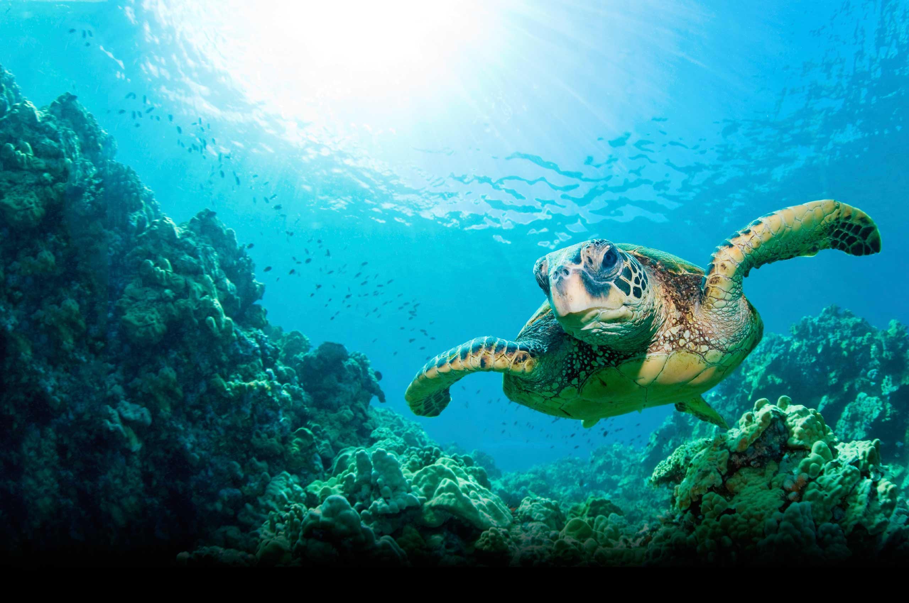


OCEAN EXPLORATION
OCEAN EXPLORATION

Slide 4
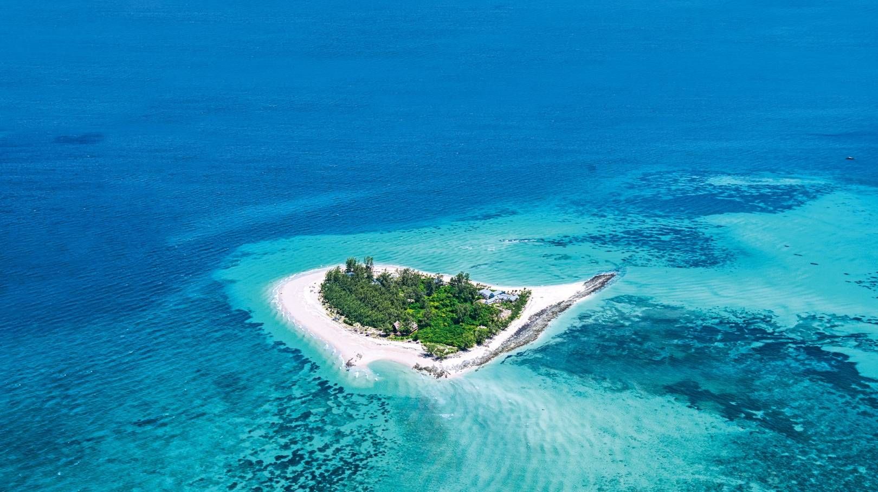
The ocean is the largest biosphere on Earth, covering nearly three-quarters of our planet’s surface and occupying a volume of 1.3 billion cubic kilometers.

Slide 5
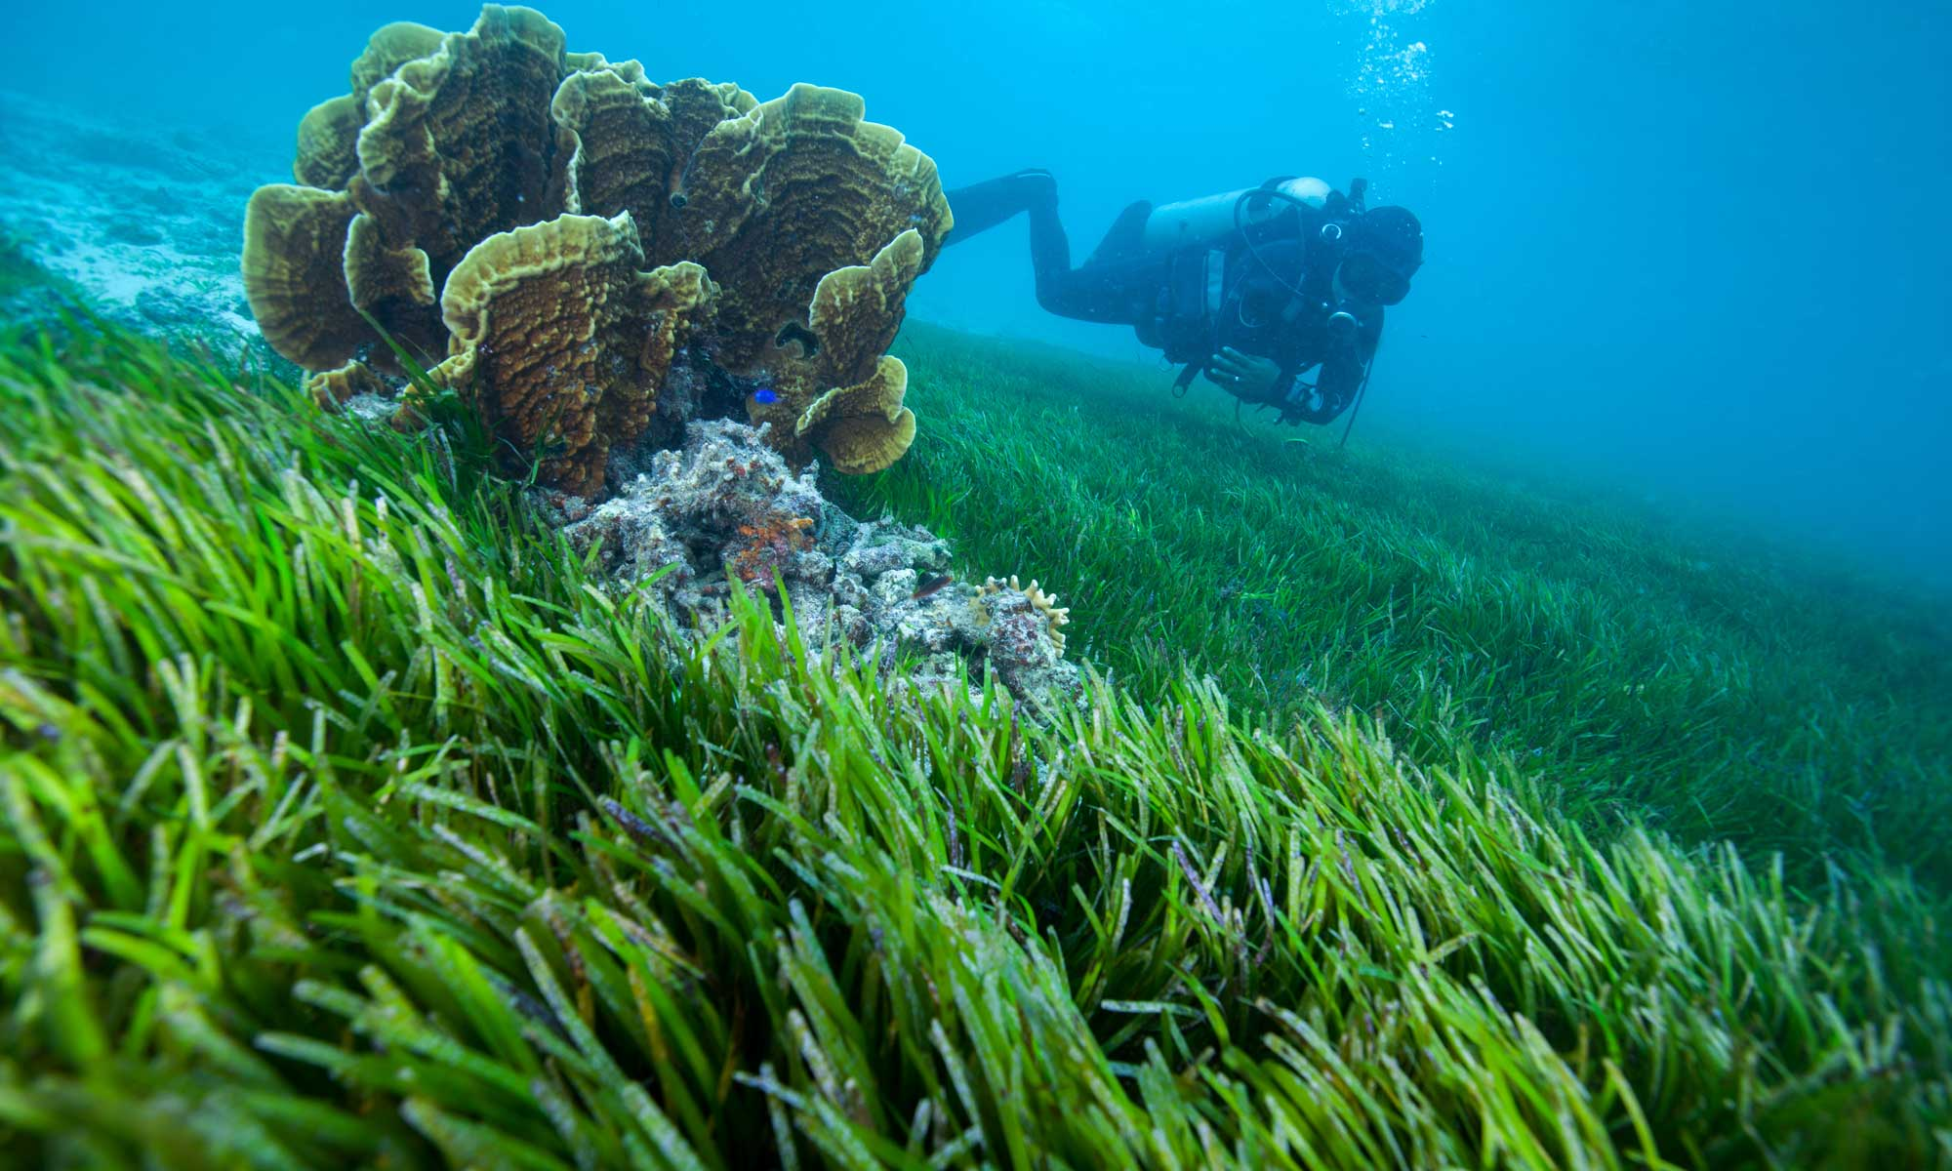
Between 70 and 80 per cent of the oxygen we breathe, along with the carbon dioxide by-product, is produced and absorbed by marine plants, nearly all of which are marine algae.

Slide 6
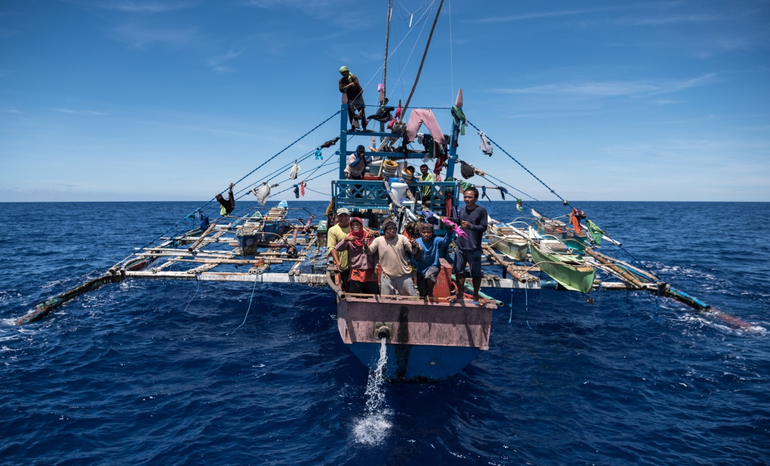
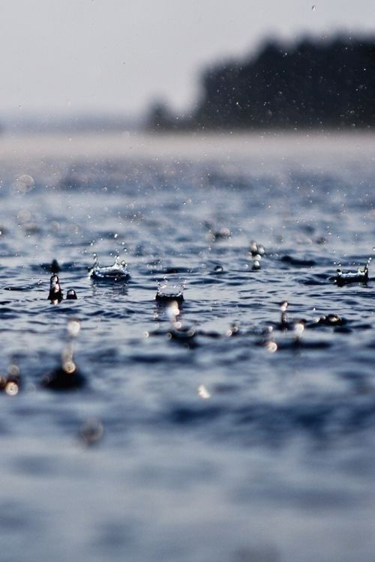
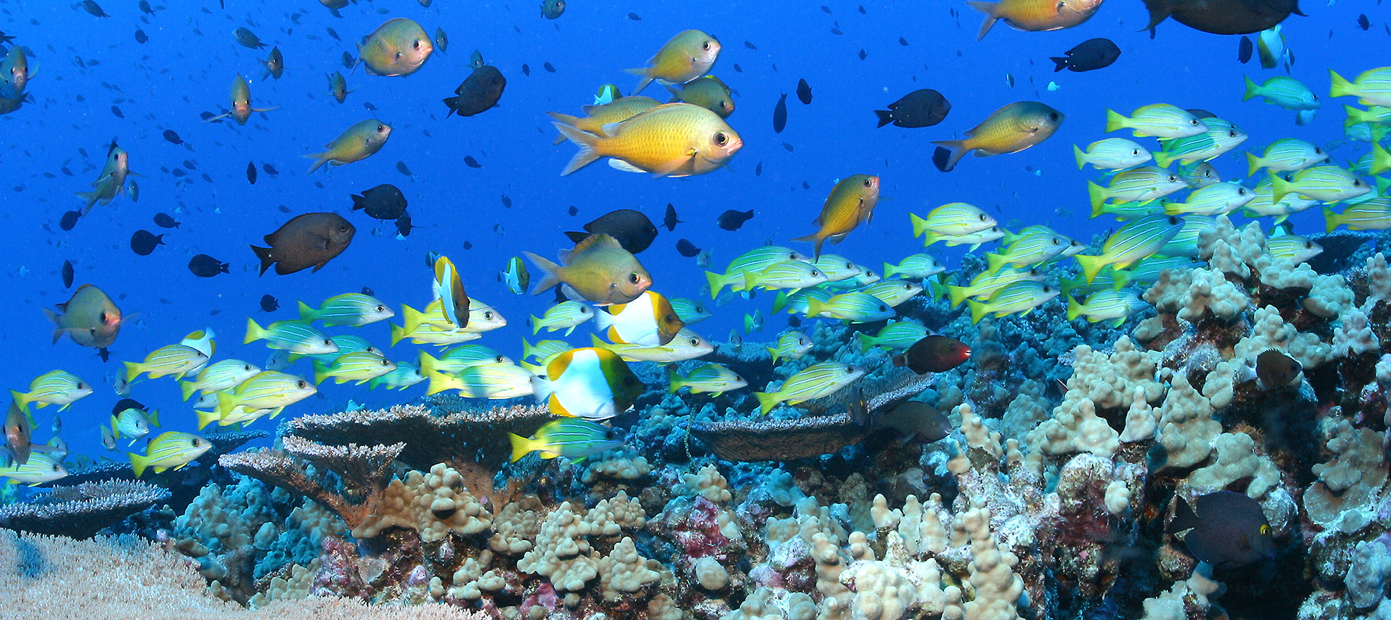
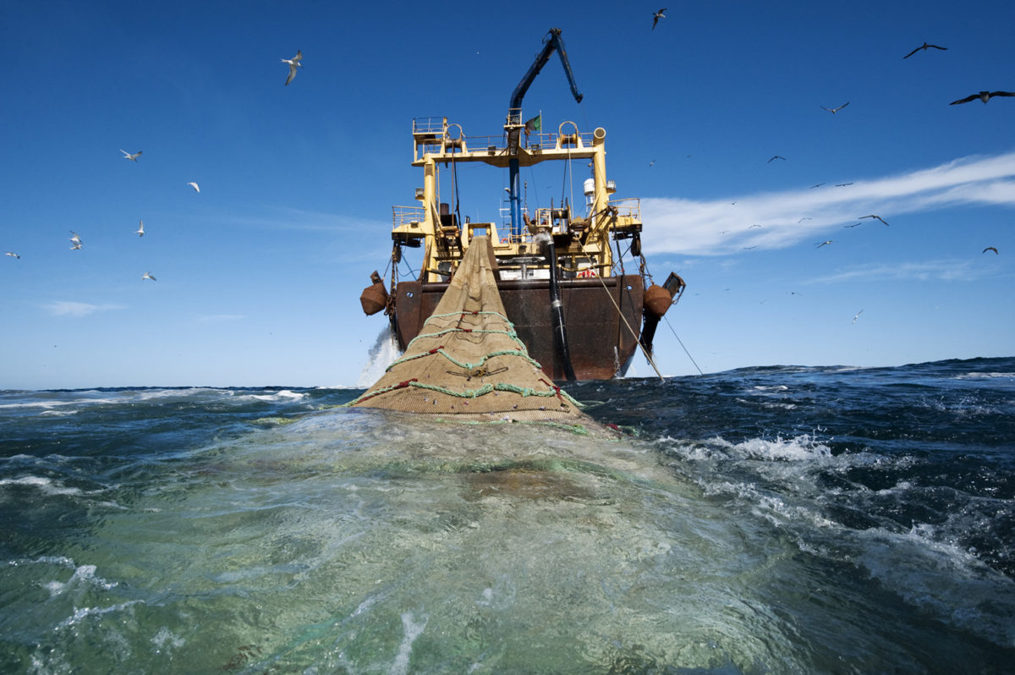
The ocean has major role in making the Earth habitable—through climate regulation, rainwater supply, petroleum and natural gas resources, seafood, pharmaceutical potential and a breathtaking diversity of species valued for their beauty.

Slide 7
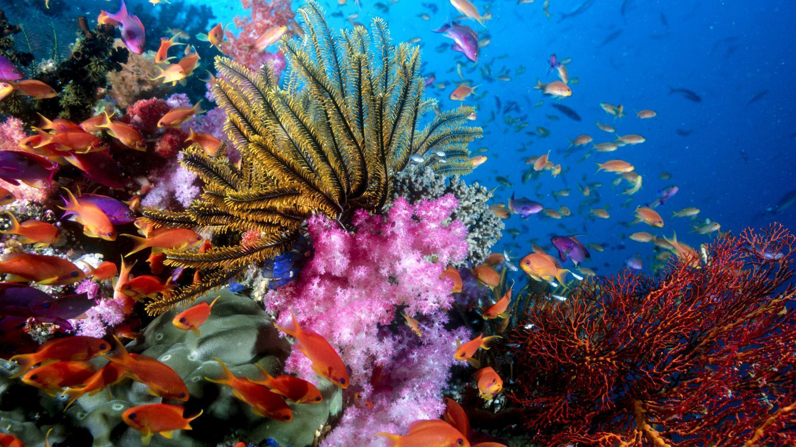
Between 700,000 and one million species live in the world's oceans, and an estimate between one-third and two-thirds of the ocean and the species in it have yet to be explored, named and described.

Slide 8
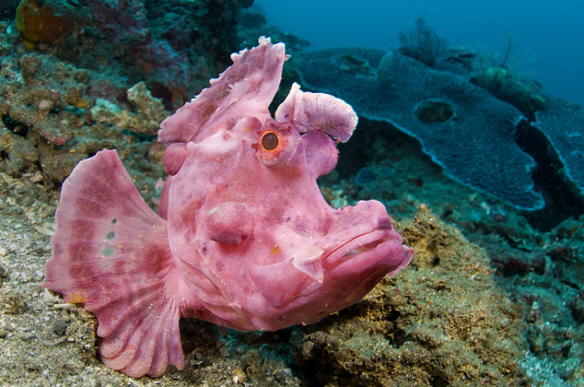
Different parts of the ocean give home different types of organisms. Each one newer and nothing less but mysterious from the other.

Slide 9
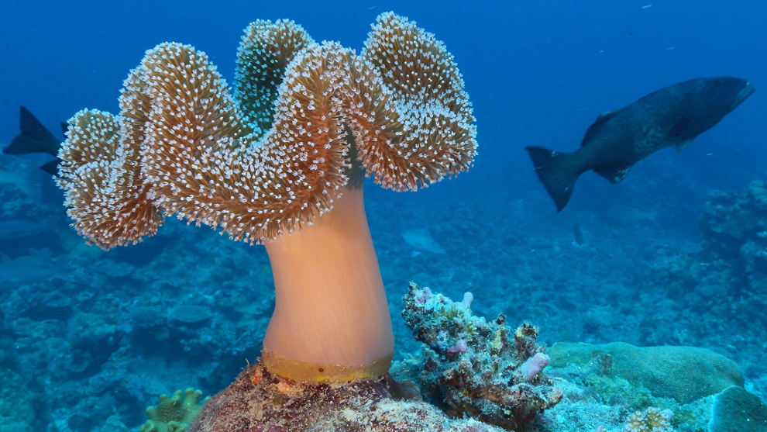
Epipelagic Zone (Sunlight Zone)
The Epipelagic zone is known as the surface layer or the sunlight zone of the ocean ranging from the surface to 656 feet. Most oceanic life and human activities like leisure, fishing, and sea transport occur in the Epipelagic zone. The coral reefs can be found in the layer and the photosynthesis process occurs here.

Slide 10
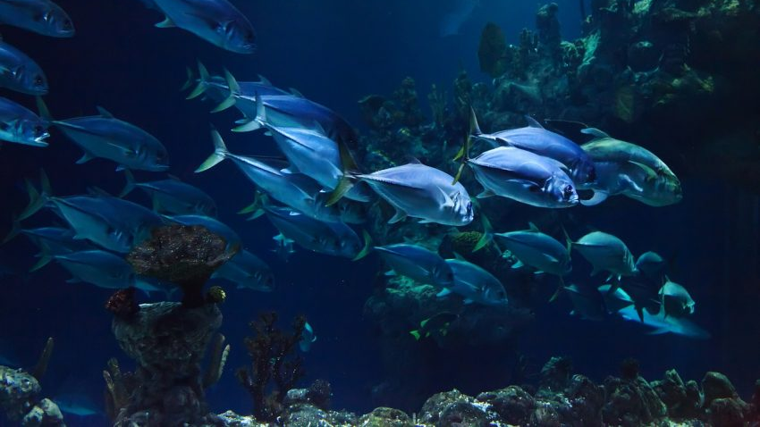
Mesopelagic Zone (Twilight Zone)
The Mesopelagic zone lies between 656 feet and 3,281 feet. The zone is home to some of the strangest sea animals like the swordfish and the wolf eel. Faint sun rays penetrate the layer.

Slide 11
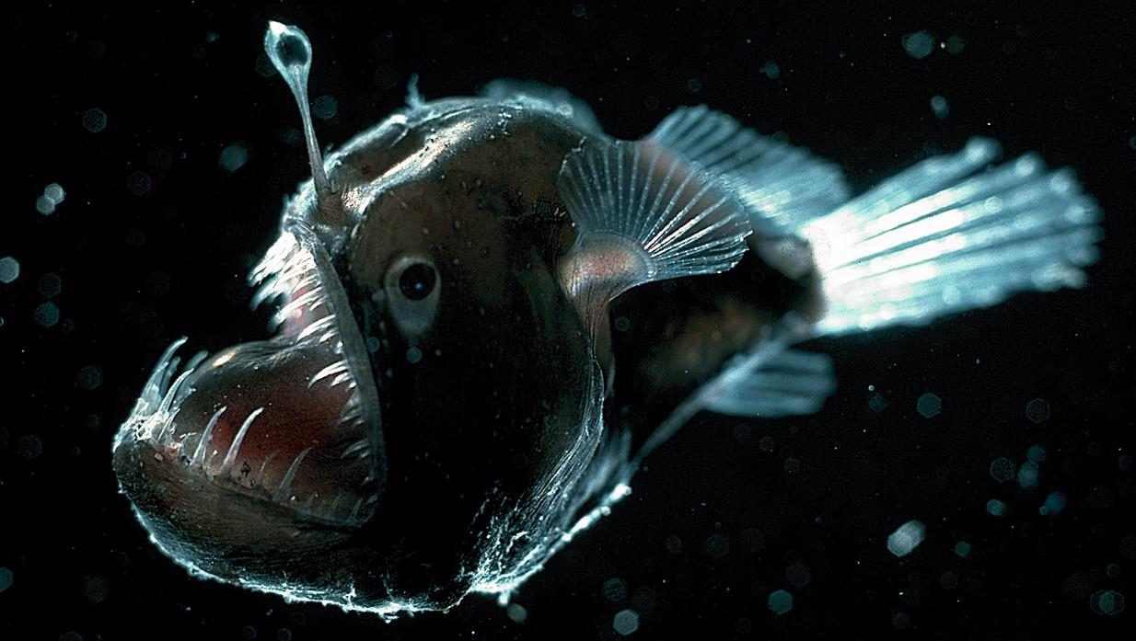
Bathypelagic Zone (Midnight Zone)
The Bathypelagic layer is found between 3,281 feet and 12,124 feet just above the Abyss. This layer is also called the midnight or the dark zone. Many animals in this layer are either black or red thanks to low sunlight penetration. Some whale species, like the sperm whale, spend some time at this level in search of food.

Slide 12
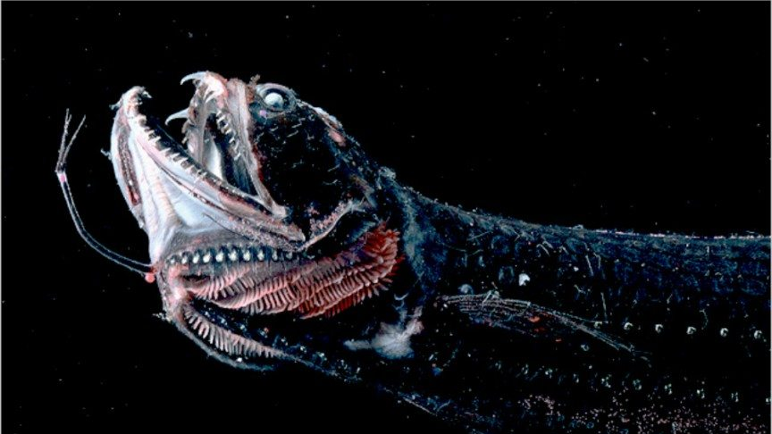
Abyssopelagic Zone (Abyss)
The Abyssopelagic zone, also known as the Abyss or Abyssal zone, lies just above the hadalpelagic layer between 13,124 feet and 19,686 feet. The layer’s name has origins in the Greek language and loosely translates to “no bottom.” Just like the layer below it, temperatures are near freezing point, and there is no penetration of natural light.

Slide 13
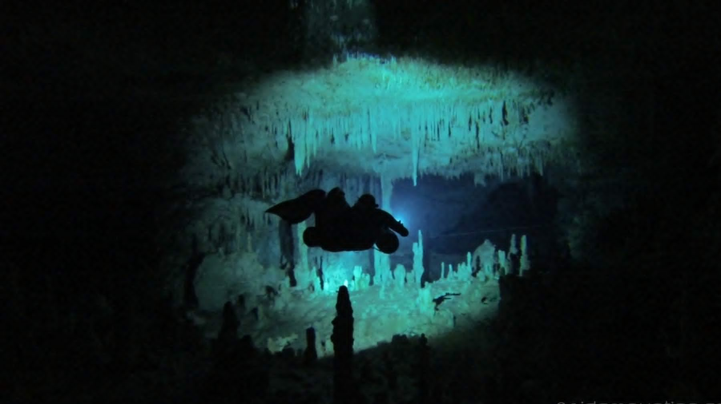
Hadalpelagic Zone (The Trenches)
The Hadalpelagic zone is also called the Trenches and is found from the ocean basin and below, between 19,686 feet to 36,100 feet. The zone cannot be explored without specialized kits due to its cold temperatures and high pressure. Natural light cannot penetrate to the Trenches. Different creatures can be found in this layer, mostly invertebrates including starfish.

Slide 14
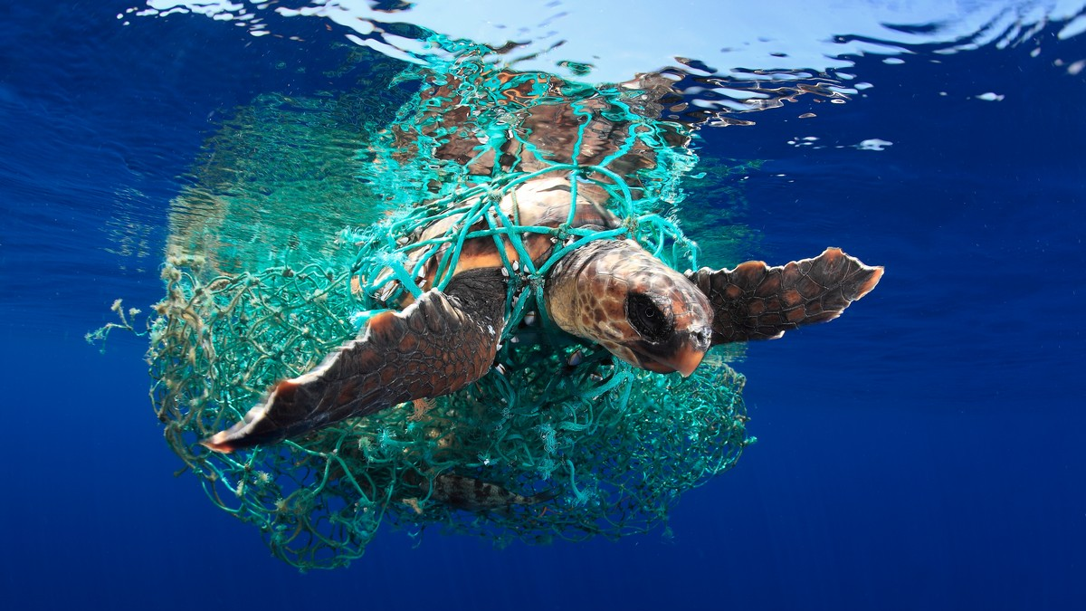
MARINE CONSERVATION

Slide 15
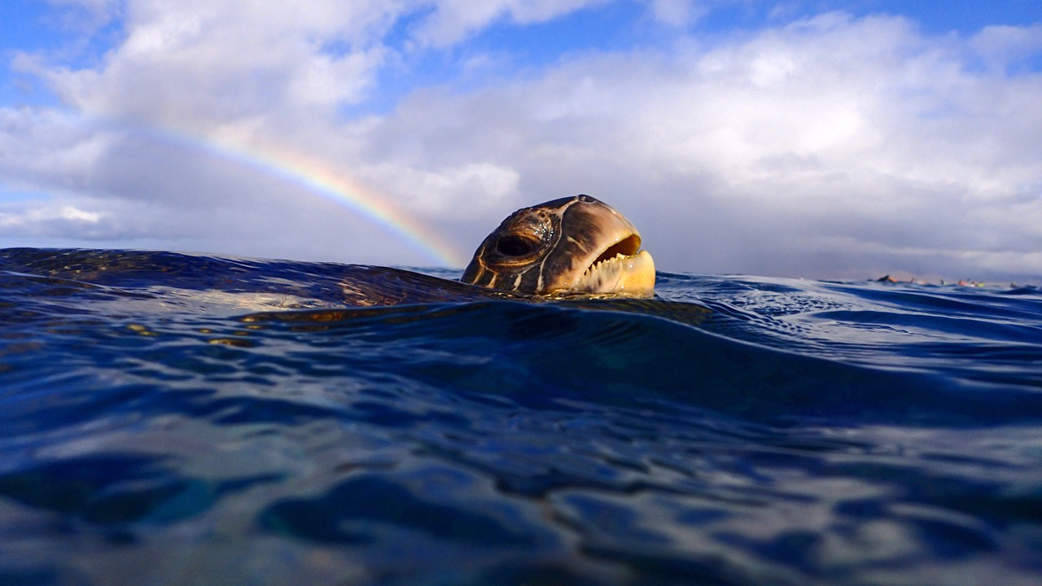

We already know that the ocean is of importance both to Diversity and in sustaining life on Earth. Thus, Marine Conservation is a must in order to maintain and protect those which provide us with what we need.

Slide 16
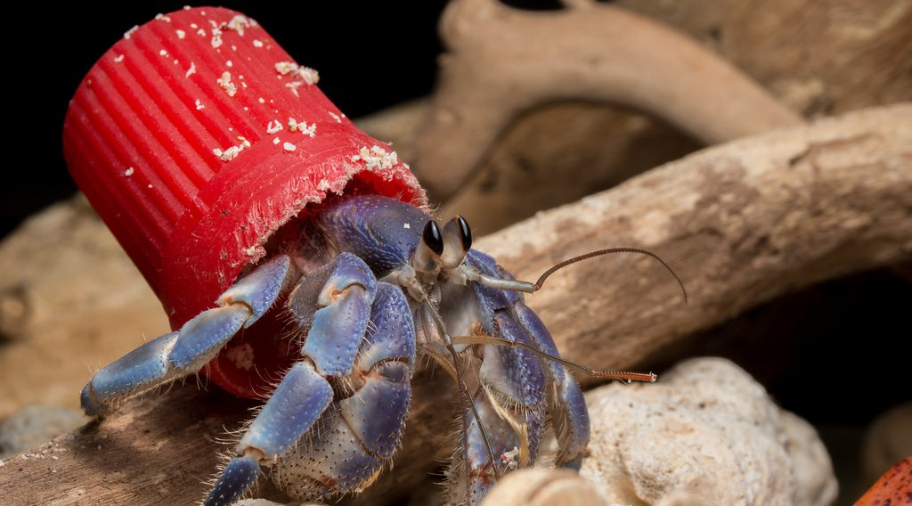
Due to human activities that have cause pollution to the marine ecosystem, the growing urgency for ocean exploration before permanent and potentially harmful changes become widespread.

Slide 17
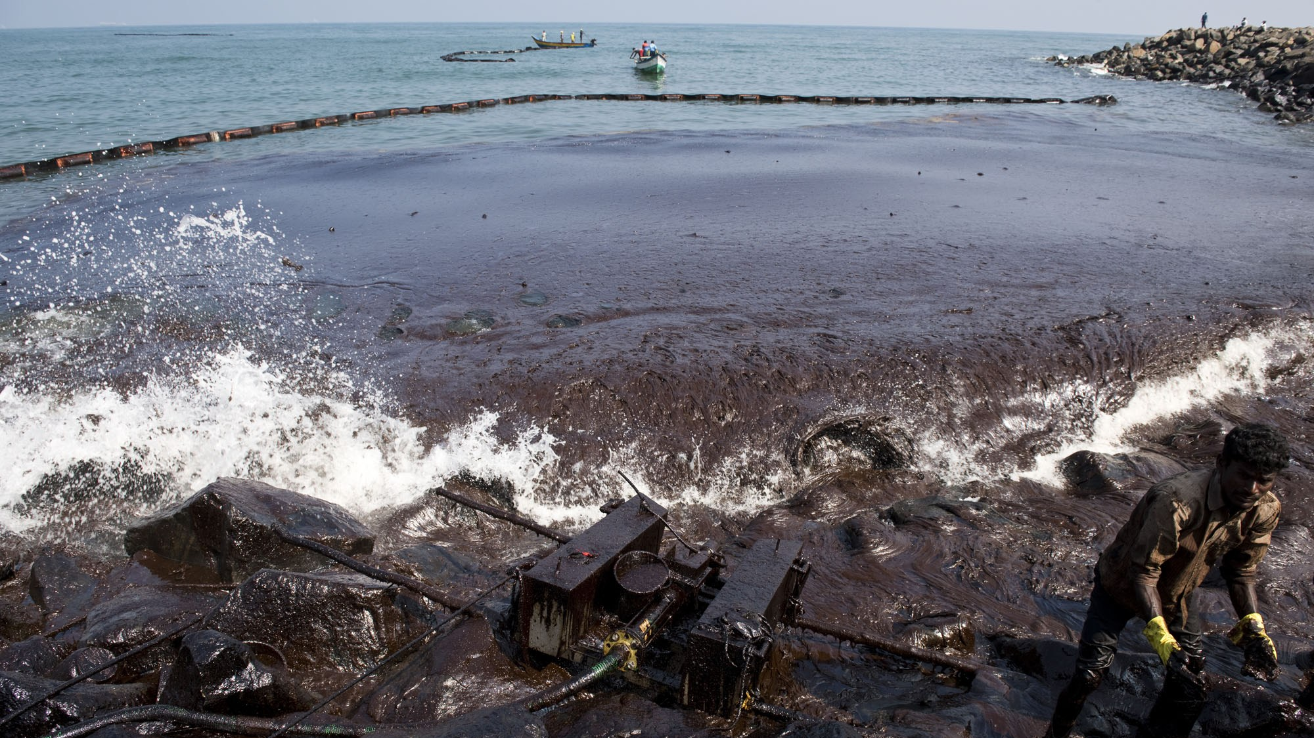
The ocean bears a double burden from the burning of fossil fuels and associated climate change; not only is it warmer, but the additional carbon dioxide dissolves in the ocean, making it more acidic.

Slide 18
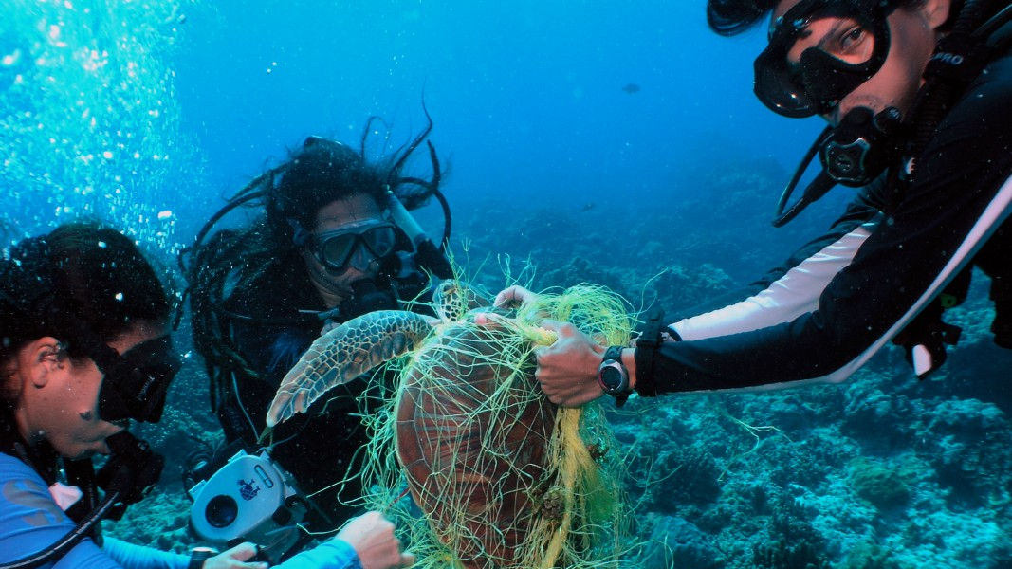
As the amount of plastic in the ocean increases, the diversity of marine life drastically decreases. The current extinction rate is now approaching 1,000 times the background rate and may climb to 10,000 times the background rate during the next century, if present trends continue, a loss that would easily equal those of past extinctions.

Slide 19
If pollution continues to worsen through the years, we may never be able to explore the remaining large portion of the ocean that is yet to be seen. Future generations may never be able to witness the beauty that marine life provides and life on Earth may become unsustainable.

Slide 20
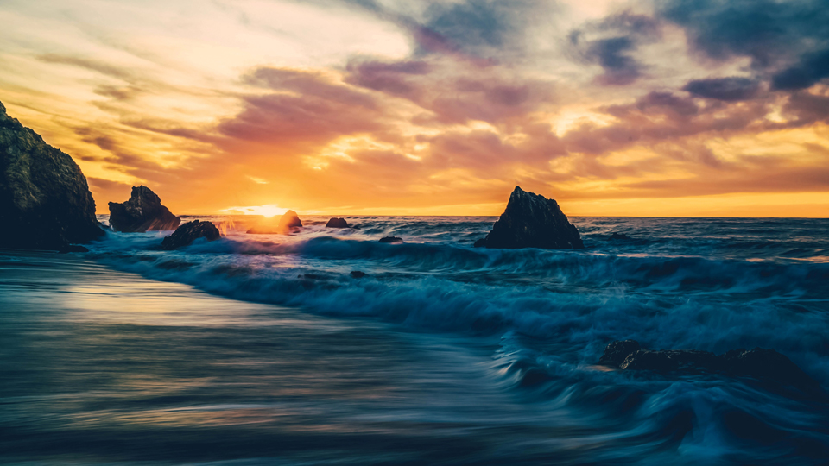

The Ocean is filled with many secrets.
We can say that what we may know about it is just the tip of the ice berg.
But if current trends do not change, that ice berg might melt
Without us knowing the mystery that lies underneath.

